Slide 1
Course: ECE249
Basic Electrical & Electronics Engineering
Unit-IV
PN Junction Diode

Slide 2
Outline
Electronic Devices
Active Devices
PN junction diode
  Basics, Circuit Symbols
  Construction
  Principle of Operation
  Diode Equation
  V-I characteristics

Slide 3
Basics of Diode
What is a Diode?
  A Diode is a TWO Terminal Device that is capable of conducting the current in ONE direction.
  “Di “= Two, and “Ode “= Electrodes i.e a device or component having two electrodes viz Anode “+” (P) and Cathode “-” (N).
What material is used to make the diode?
  Silicon, Germanium etc…
How to get a P- Type Material?
  A semiconductor may be doped with acceptor impurities such as Boron, Indium, aluminium (P-type doping), so that it contains mobile charges which are mainly holes.

Slide 4
Cont…
How to get a N-type Material?
  A semiconductor may be doped with donor impurities such as Antimony, Phosphorous, Arsenic (N-type doping), so that it contains mobile charges which are primarily electrons.
What are mobile charge carriers in Semiconductors?
  Holes & Electrons
  The holes are positively charged while the electrons negatively charged.

Slide 5
Cont…
Intrinsic and Extrinsic semiconductor.
An intrinsic semiconductor is a pure semiconductor in which hole and electrons are available in equal numbers at room temperature.
In an extrinsic semiconductor, impurities are added to increase the number of holes or the number of electrons.
A photodiode is used in solar cells and photometers.

Slide 6

Circuit Symbol - PN Junction Diode

Slide 7
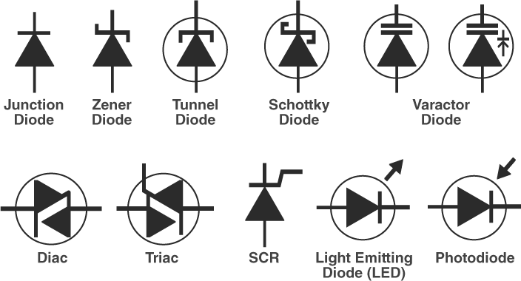
Circuit Symbol of Other Diodes

Slide 8
Construction
If we add trivalent impurities in silicon or germanium, a greater number of holes are present and it is a positive charge. Hence, this layer is known as the P-type layer.
If we add pentavalent impurities in silicon or germanium, a greater number of electrons are present and it is a negative change. Hence, this layer is known as the N-type layer.
The diode is formed by joining both N-type and P-type semiconductors together. This device is a combination of P- type and N-type semiconductor material hence it is also known as PN Junction Diode.

Slide 9
Cont…
A junction is formed between the P-type and N-type layers. This junction is known as PN junction.
A diode has two terminals; one terminal is taken from the P-type layer and it is known as Anode. The second terminal is taken from the N-type material and it is known as Cathode.

Slide 10

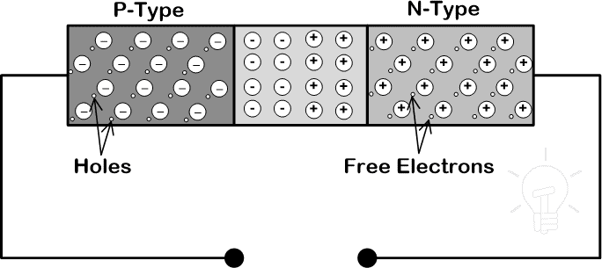
Cont…

Slide 11
Principle of Operation
Zero – Bias
Forward Bias
Reverse Bias

Slide 12
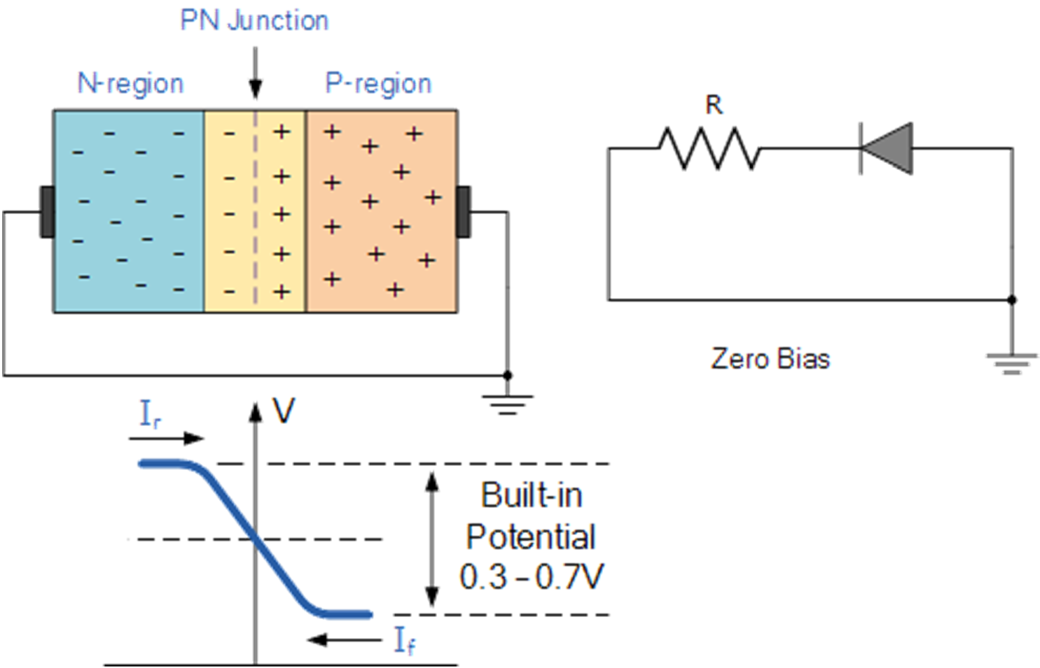
Zero Bias
No external voltage potential is applied to the PN junction diode

Slide 13
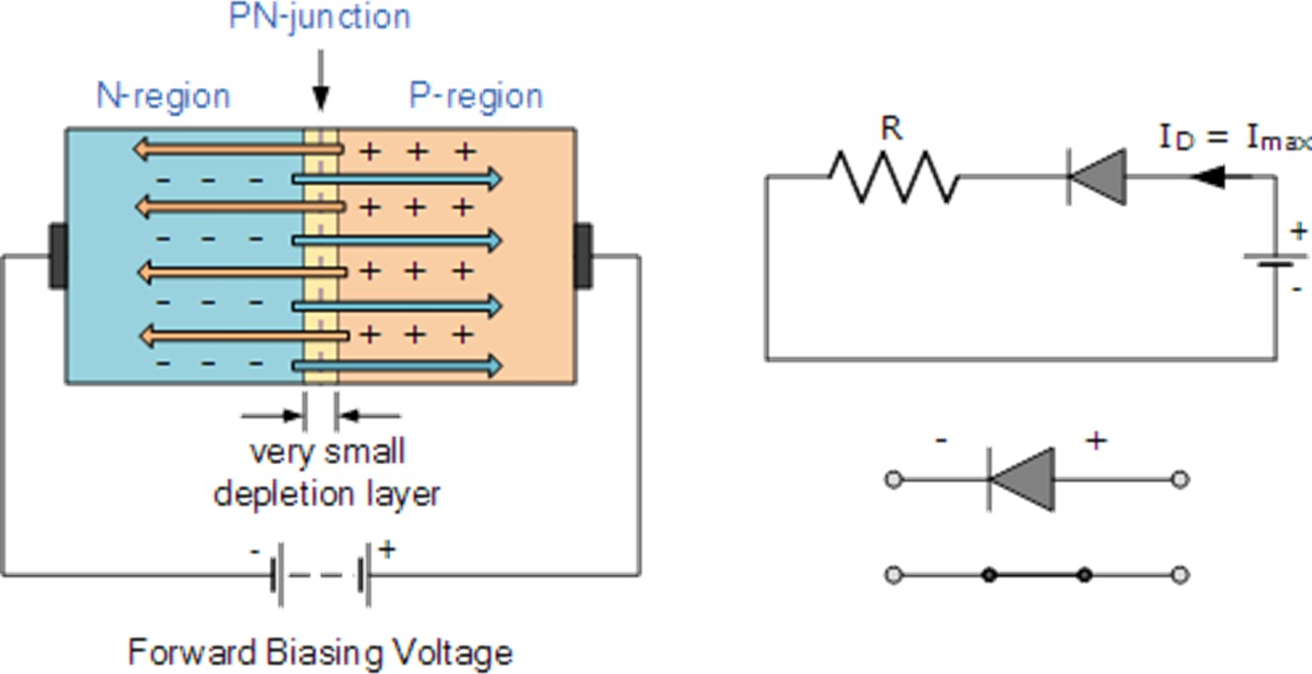
Forward Bias
The voltage potential is connected positive, (+ve) to the P-type material and negative, (-ve) to the N-type material across the diode which has the effect of Decreasing the PN junction diodes width.

Slide 14
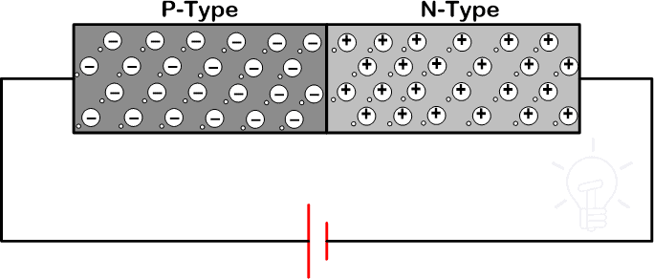
Cont…

Slide 15
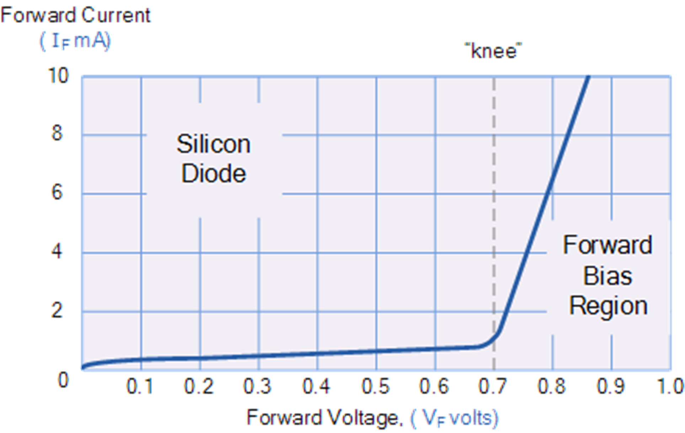
Forward Bias Characteristics

Slide 16
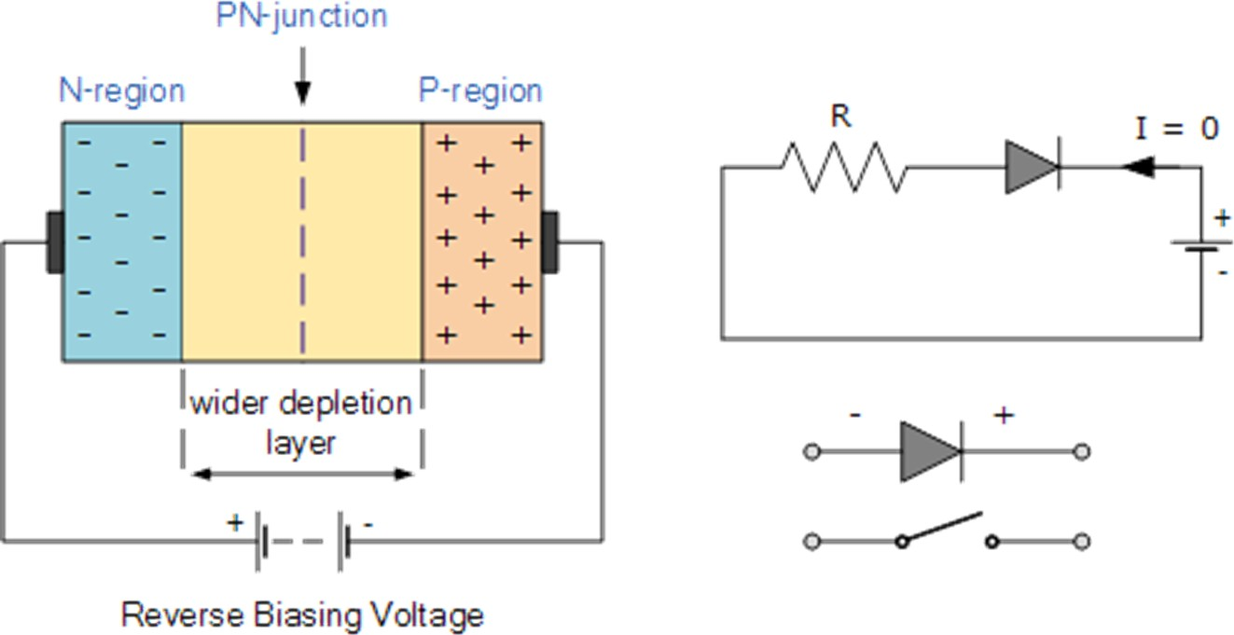
Reverse Bias
The voltage potential is connected negative, (-ve) to the P-type material and positive, (+ve) to the N-type material across the diode which has the effect of Increasing the PN junction diode’s width.

Slide 17
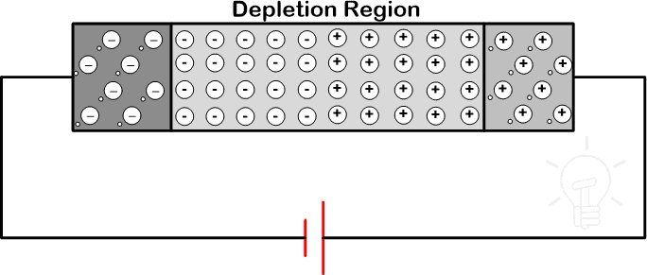
Cont…

Slide 18
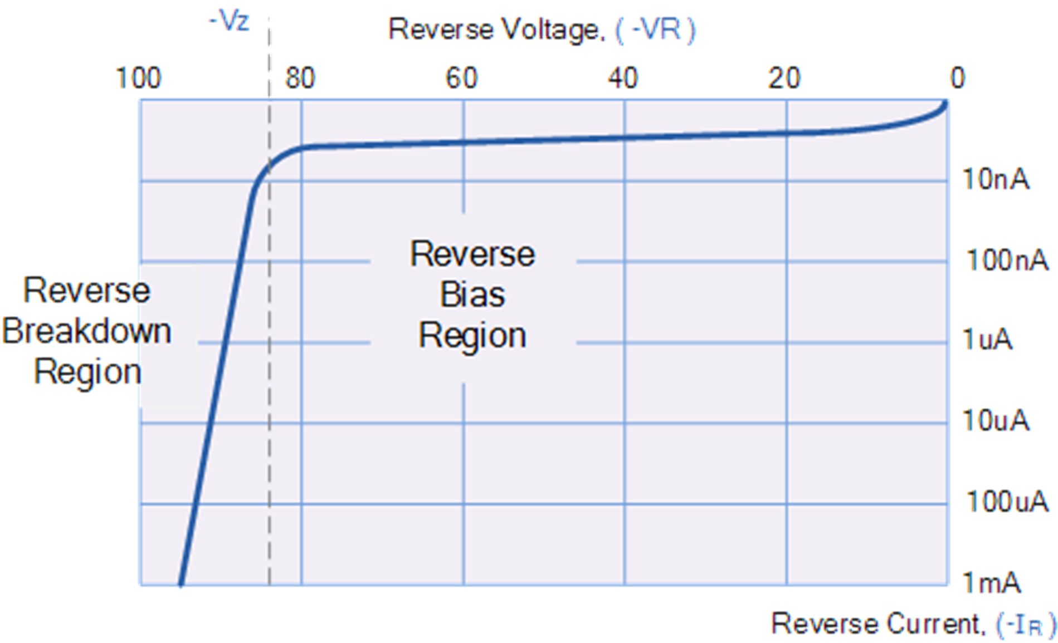
Reverse Bias Characteristics

Slide 19
Important Terminologies
Depletion Region: The junction region itself has no charge carriers and is known as the depletion region.
The junction (depletion) region has a physical thickness that varies with the applied voltage.
Depletion Region @ Zero Bias: When a diode is Zero Biased no external energy source is applied and a natural Potential Barrier is developed across a depletion layer which is approximately 0.5 to 0.7v for silicon diodes and approximately 0.3 of a volt for germanium diodes.

Slide 20
Cont…
Depletion Region, Forward Bias : When a junction diode is Forward Biased the thickness of the depletion region reduces and the diode acts like a short circuit allowing full circuit current to flow.
Depletion Region, Reverse Bias: When a junction diode is Reverse Biased the thickness of the depletion region increases and the diode acts like an open circuit blocking any current flow, (only a very small leakage current will flow).

Slide 21
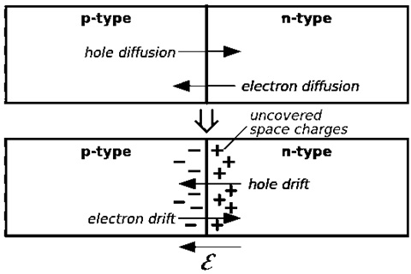
Cont…
Drift Current: Drift current can be defined as the charge carrier’s moves in a semiconductor because of the electric field.

Slide 22
Cont…
Diffusion Current: The diffusion current can be defined as the flow of charge carriers within a semiconductor travels from a higher concentration region to a lower concentration region.
Cause: Non-uniform doping

Slide 23

Diode Current Equation
Current
Equation: The diode current equation
expresses the relationship between the Current flowing through the diode as a function of the Voltage applied across it. Mathematically the diode current equation can be expressed as:

Slide 24
Cont…
Where
I is the current flowing through the diode
I₀ is the dark saturation current,
q is the charge on the electron, (1.602 x 10^(-19) Coulomb)
V is the Voltage applied across the diode,
η is the (exponential) ideality factor.
K is Boltzmann Constant, 1.38 x 10^(-23) J/K
T is the absolute temperature in Kelvin

Slide 25
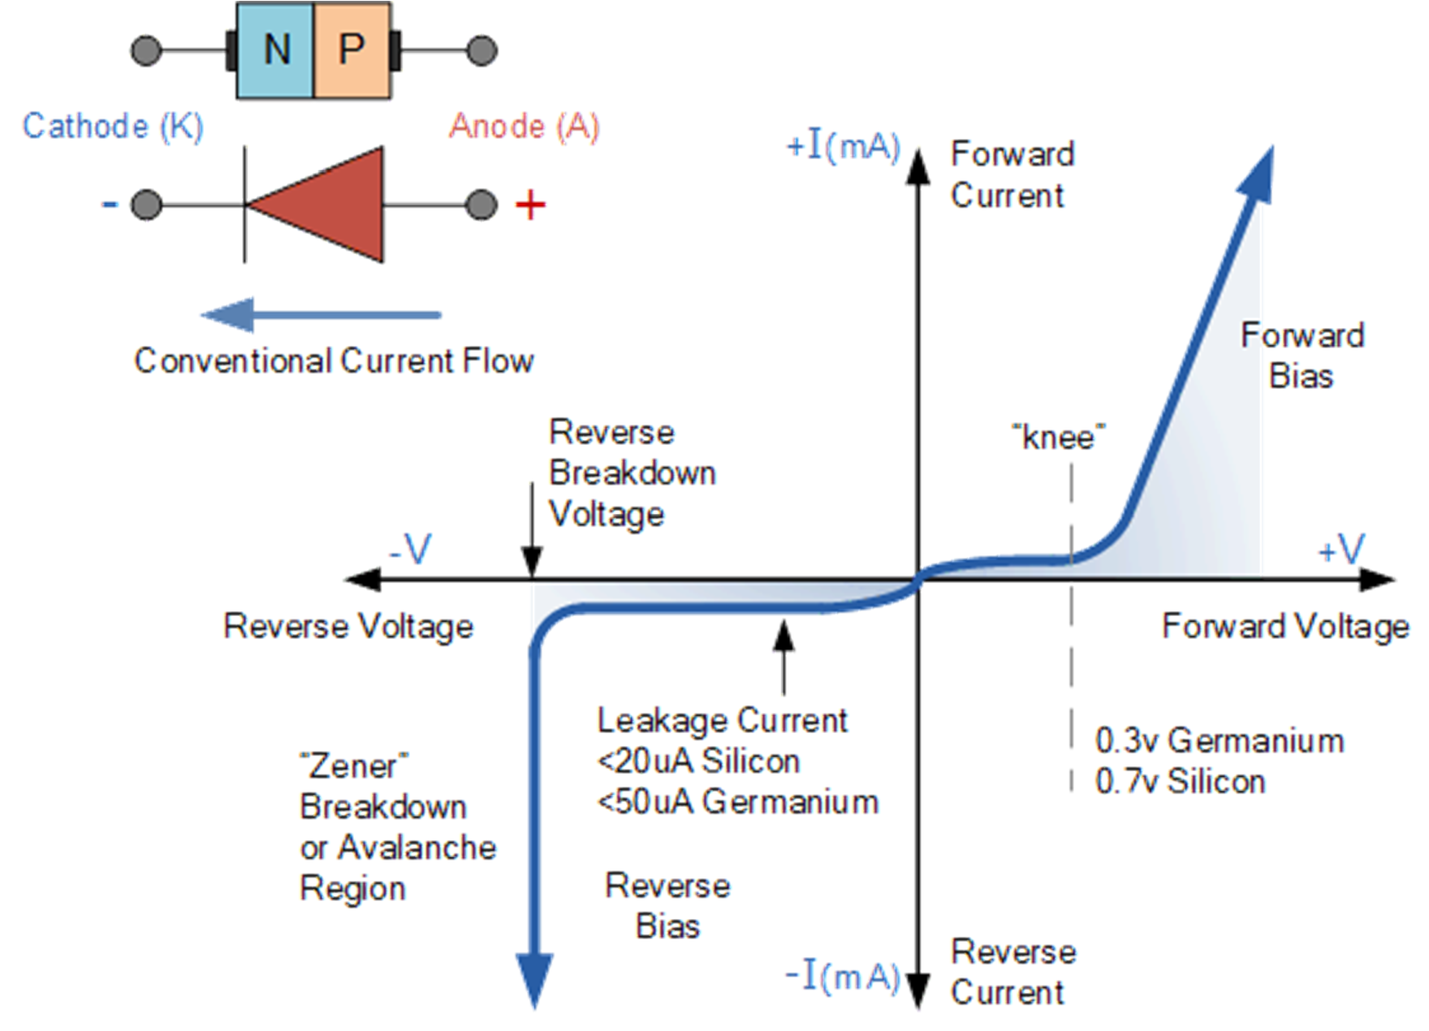
Volt-Ampere (V-I) Characteristics

Slide 26
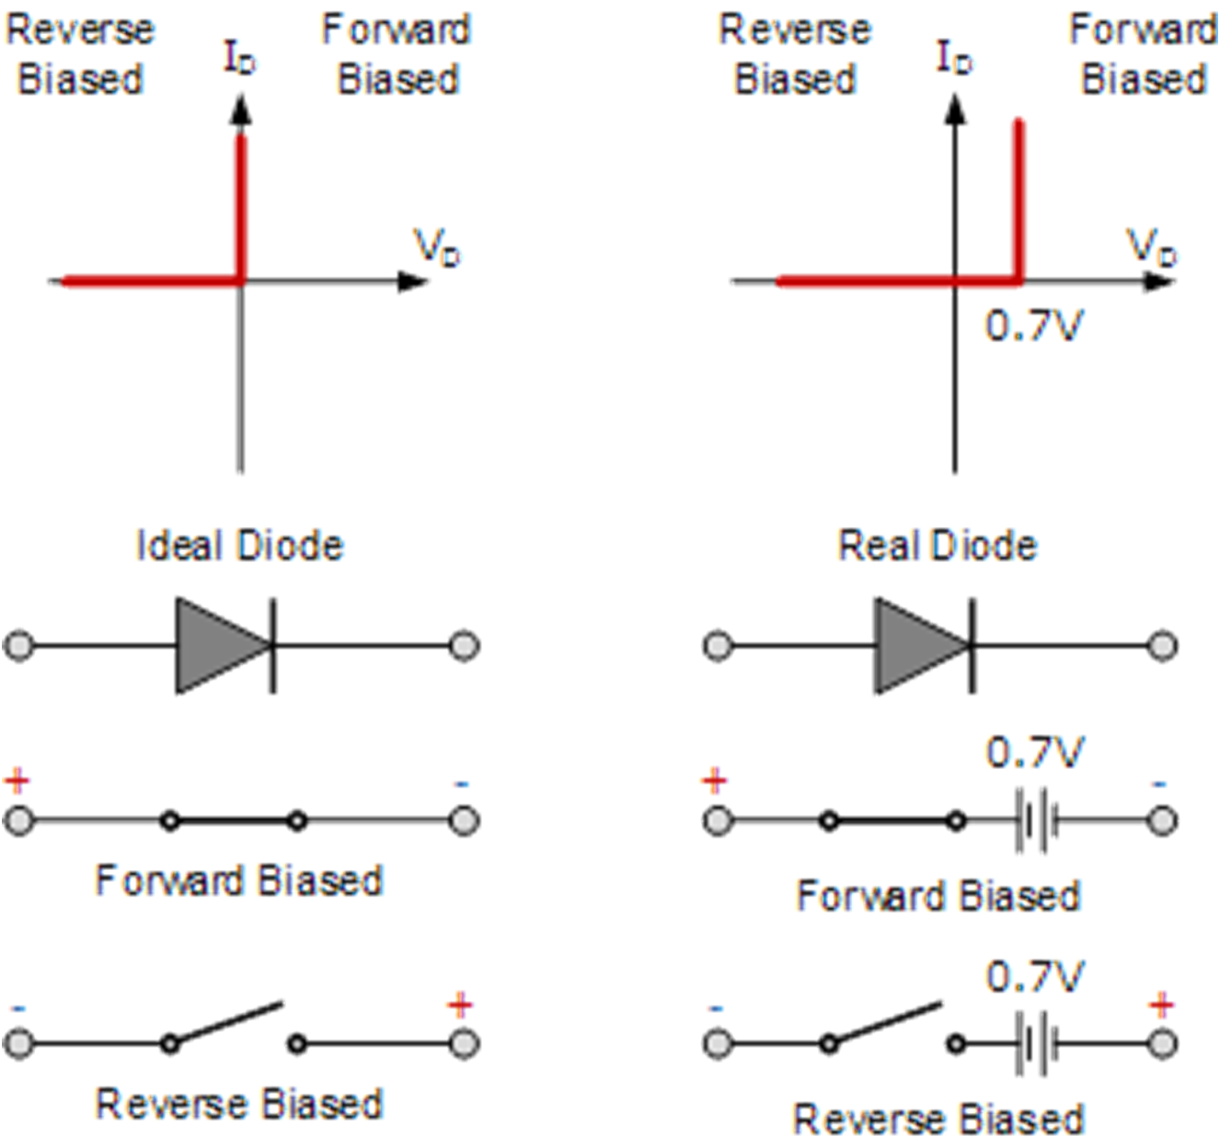
Ideal & Real Diode Characteristics

Slide 27
PN Junction Diode Applications
Rectification (Half Wave / Full Wave).
As a Switch (in Logic Gates)
Source Isolation.
As Voltage Reference / Voltage Regulator.
Frequency Mixer.
AM Envelope Detector or Demodulator (Diode Detector)
Diode as Light Source.
As a Sensor.

